Slide 1
Counsellor Scorecard Dashboard Highlights:
Structured to comprise 3 “levels”; Departmental/channel, Team, and Counsellor
Accessible via web link (https://apps.kidshelpphone.ca/tools/counselling-kpis-stats/index.html) – ‘Quality Analytics’ section
Dashboard updates dynamically as categories/content is selected
ETL process starts with iCarol raw data extract, then data is cleaned and pasted into PowerBI-linked dataset

Slide 2
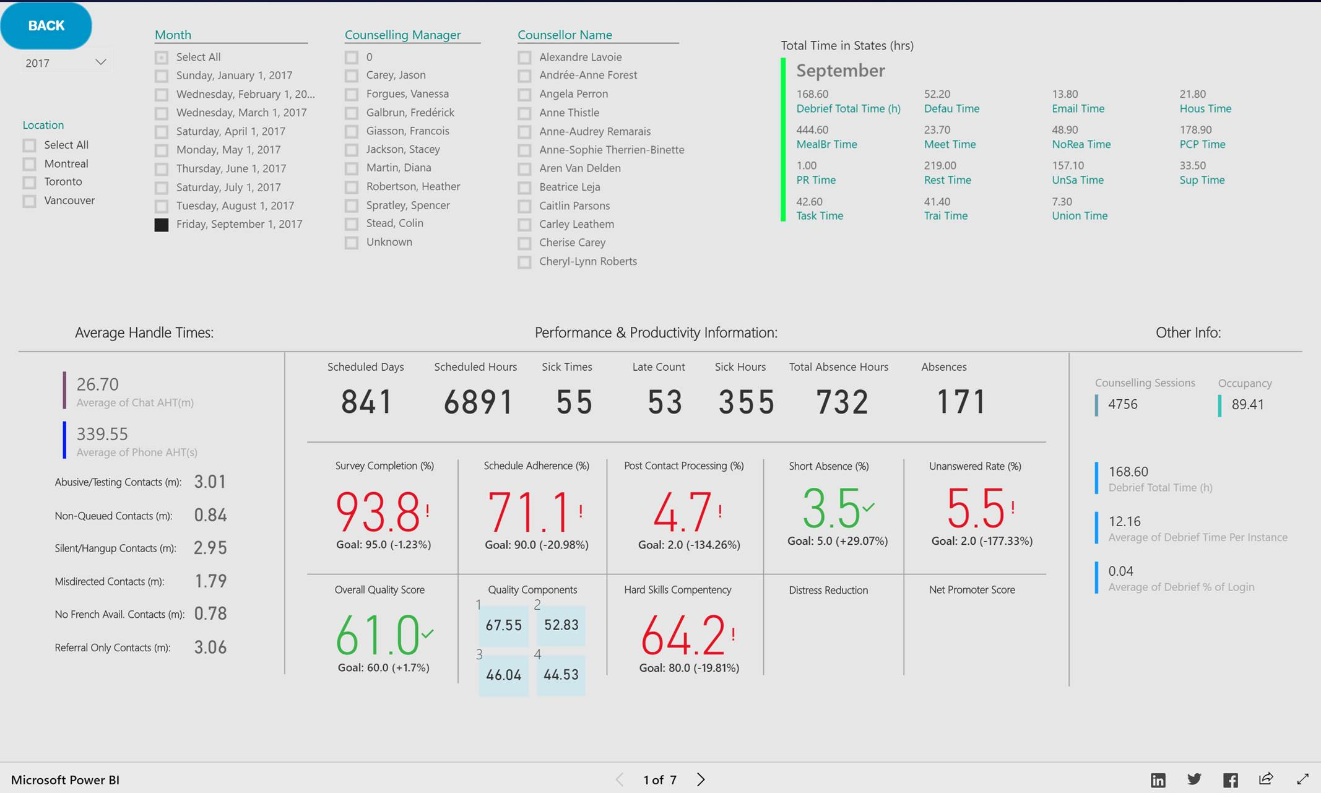
Criteria and drilldowns of site, team, and individual, can be done in real-time, with the data updating dynamically as criteria is selected.
Time in states displays total time spent by individual, or group, in each Not Ready state (for visibility to work patterns)
Counselling Session, Occupancy, and Debrief specific information provides more context to the working environment and behaviours of group sand individuals
Visibility to LOB-specific handle time averages help managers detect and understand on-call behaviours of counsellors. Counsellors spending too much time on non-counselling calls can be quickly identified and coached.
All main KPI metrics are covered here, displaying both the actual achieved score, a colour-coded indicator as to if the resulting score was within, or outside of, the target for that metric, and visibility to the net differential. This also contains Quality overall scores as well as specific Quality pillar scores for quick-hit visibility to proficiencies and focus areas.
Above it, Absence rates, instances, and total hours are displayed for quick and effective visibility to trends and behaviours.

Slide 3
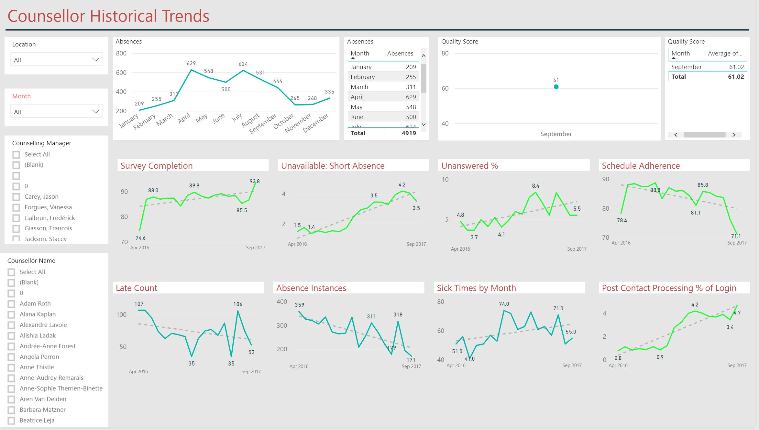
Historical data for each KPI shows trends in results and performance over a period of monthly intervals
Criteria and drilldowns of site, team, and individual, can be done in real-time, with the data updating dynamically as criteria is selected.

Slide 4
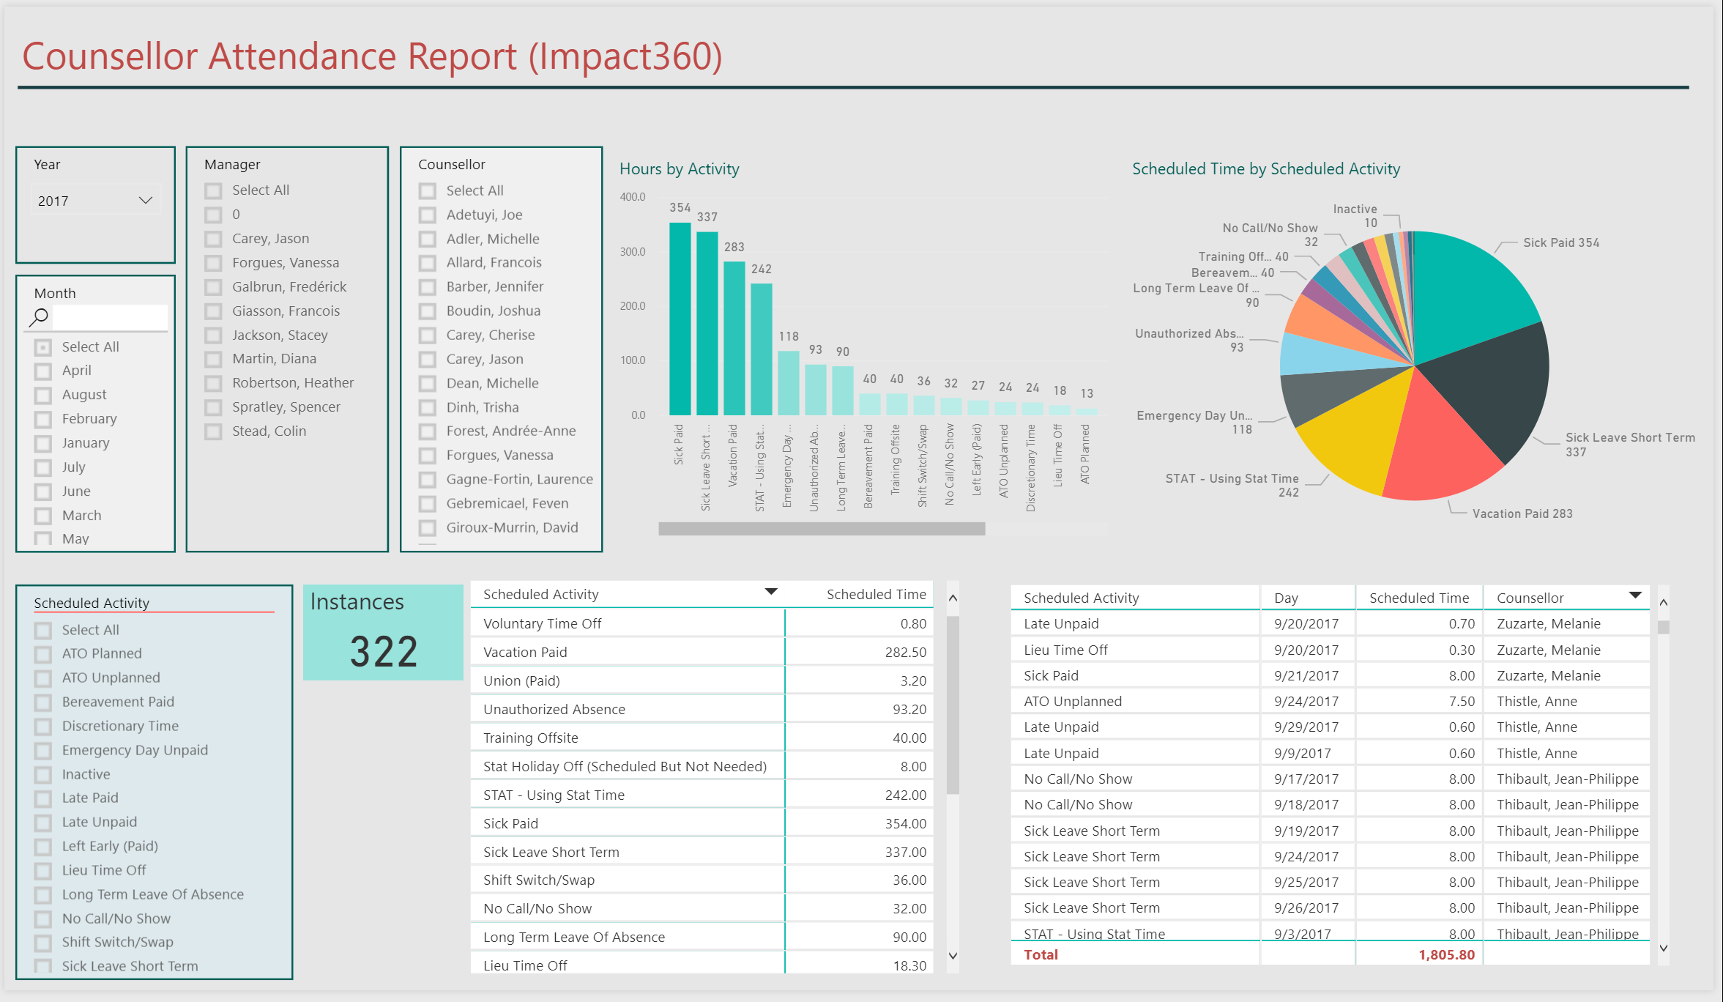
Criteria and drilldowns of site, team, and individual, can be done in real-time, with the data updating dynamically as criteria is selected.
Attendance data helps managers understand absence rates and identify troublesome behaviours that can be addressed through supervision

Slide 5
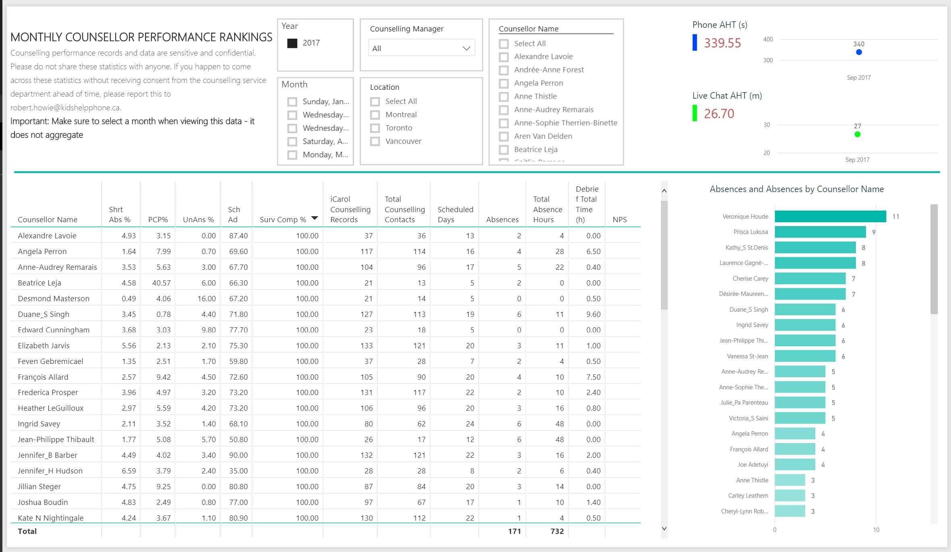
Criteria and drilldowns of site, team, and individual, can be done in real-time, with the data updating dynamically as criteria is selected.
This view of all counsellors and all KPIs allows the user to sort lowest/highest, and quickly identify who the top-ranked performers are in each category. This also helps managers understand the degree of spread between lowest, average, and highest.

